Slide 1
Structure of Viruses
Dr.Sonal Mishra

Slide 2
Viral Structure

Slide 3
Characteristics
Non living structures
Noncellular
Contain a protein coat called the capsid
Have a nucleic acid core containing DNA or RNA
Capable of reproducing only when inside a HOST cell

Slide 4
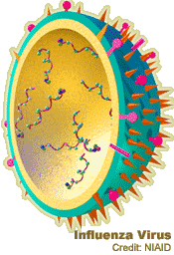
Characteristics
Some viruses are enclosed in an protective envelope
Some viruses may have spikes to help attach to the host cell
Most viruses infect only SPECIFIC host cells
CAPSID
DNA
ENVELOPE
SPIKES

Slide 5
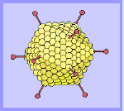
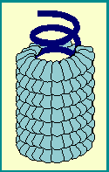
Characteristics
Viral capsids (coats) are made of individual protein subunits
Individual subunits are called capsomeres
CAPSOMERES

Slide 6

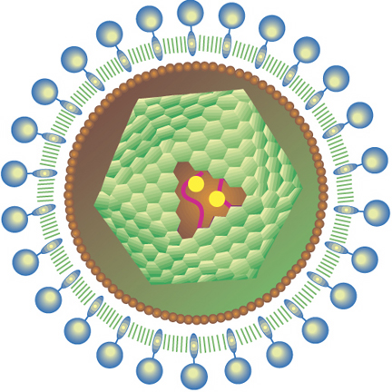
Characteristics
Outside of host cells, viruses are inactive
Lack ribosomes and enzymes needed for metabolism
Use the raw materials and enzymes of the host cell to be able to reproduce
EBOLA VIRUS
HIV VIRUS

Slide 7
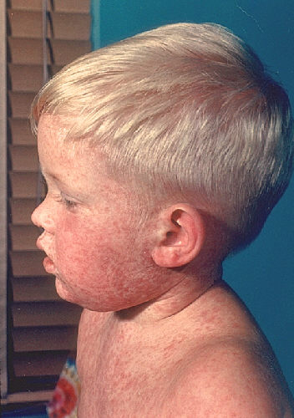
Characteristics
Some viruses cause disease
Smallpox, measles, mononucleosis, influenza, colds, warts, AIDS, Ebola
Some viruses may cause some cancers like leukemia
Virus-free cells are rare
MEASLES

Slide 8
Viral Shapes
Viruses come in a variety of shapes
Some may be helical shape like the Ebola virus
Some may be polyhedral shapes like the influenza virus
Others have more complex shapes like bacteriophages

Slide 9
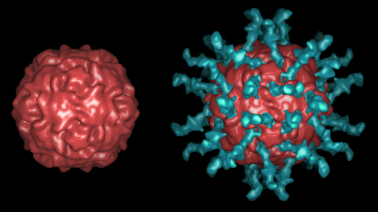
Viral Shapes
Polyhedral: polio

Slide 10
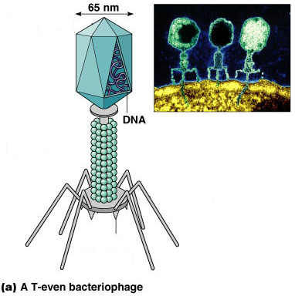
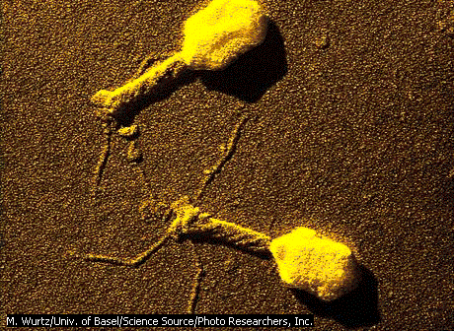
Virus Kompleks
Kapsid / Kepala
Selubung Ekor
Serabut Ekor

Slide 11
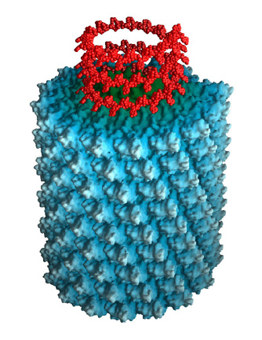
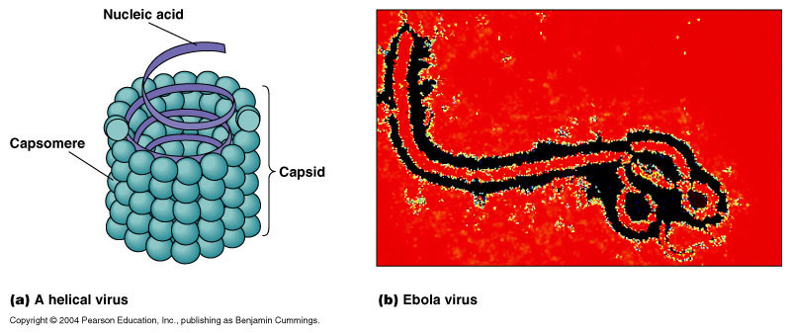
Viral Shapes
Cylindrical: tobacco mosaic

Slide 12
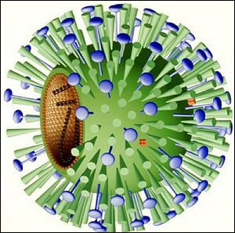
Viral Shapes
Studded capsid: HIV, influenza

Slide 13
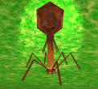
Viral Shapes
Polyhedral head with protein tails: bacteriophage

Slide 14
Helical Viruses

Slide 15
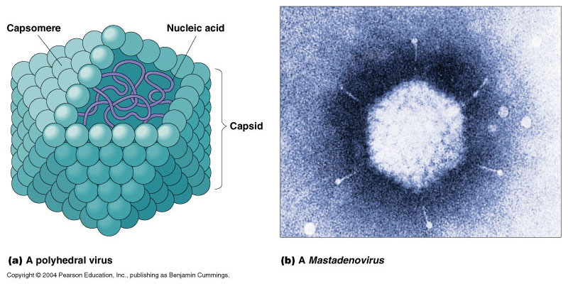
Polyhedral Viruses

Slide 16
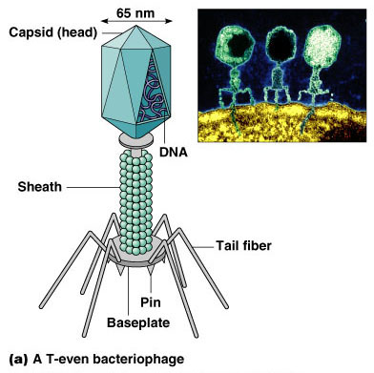
Complex Viruses

Slide 17
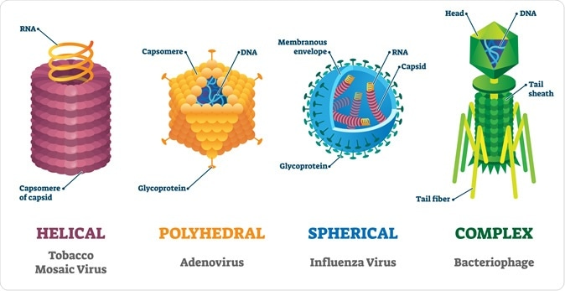
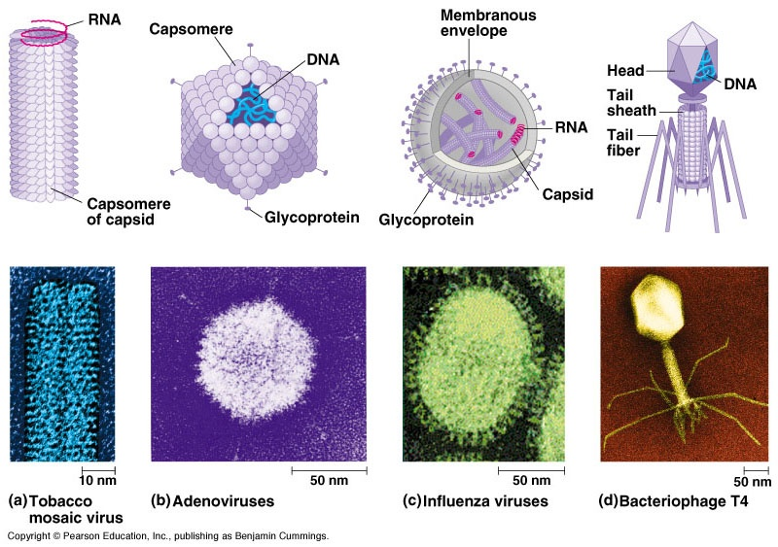
Virus Morphology
* All virus have these two features

Slide 18
Virus Morphology
* All virus have these two features

Slide 19
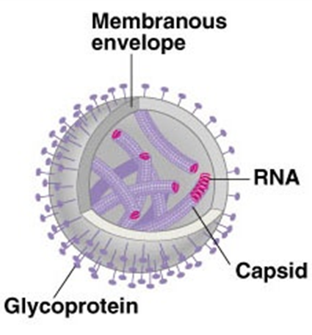
Virus Morphology

Slide 20
Virus Morphology

Slide 21
Host Range and Specificity of Viruses
•Viruses can infect all forms of life (algae, bacteria, fungi, protozoa, plants , animals, and even archaea.
•But for most viruses, each virus is limited to one host or even to one type of cells or tissues of the host.
•Host range of a virus is the spectrum of hosts that the virus can infect.
–e.g. poliovirus causes infection to humans only, while rabies virus causes infection to many warm blooded animals.
•Viral specificity refers to the specific kind of cells a virus can infect (called tissue tropism).
–e.g. some papillomaviruses infect only skin cells (warts), while cytomegalovirus (have lethal effects) can attack salivary glands, GIT, liver, lungs, crosses placenta & attacks foetus.
–“one virus, one disease” concept is not necessarily true!

Slide 22
Host Range and Specificity of Viruses
•Viral specificity is determined by:
The ability of a virus to attach to the host cell.
i.e. depends on presence of specific receptor on host cell & specific attachment structure on viral capsid or envelope.
2. Presence of enzymes & proteins in the host that the virus needs in order to replicate itself inside the host cell.
3. Ability of viruses to be released from the cell.
•Viruses can’t reproduce by themselves, they must infect host cells, un-coat their genetic material and use the host’s machinery to replicate.
•Whether viruses are living or non-living is still a debate?
–Non-living: can’t reproduce alone, no metabolism.
–Living: because they have genetic material that is active after infection.

Slide 23


